Slide 1
27 Intro to Input and Interaction Part 2
CS 142
David Anderson
Slides by Martin Hock

Slide 2
Overview
We’ll write the code to get input from the user for the guessing game

Slide 3
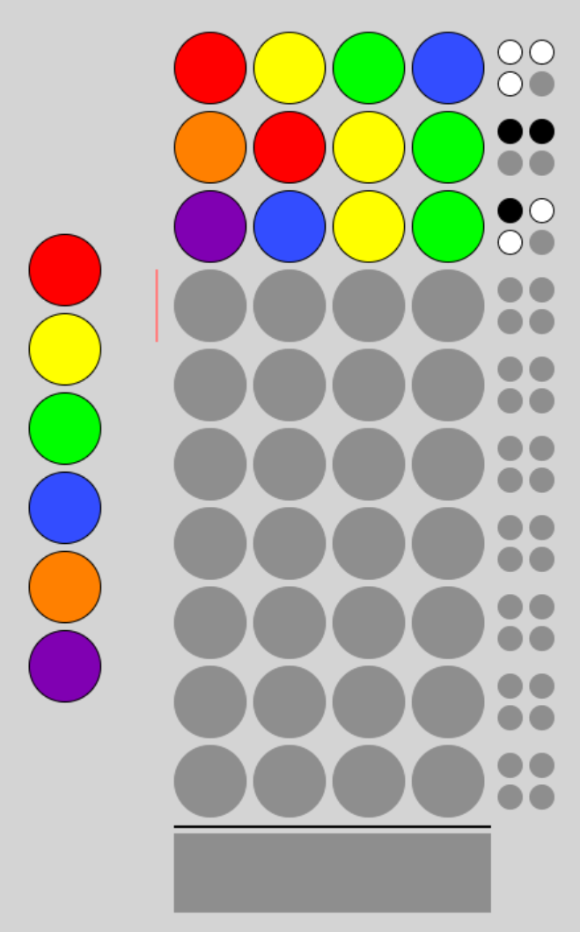
Review: Guessing game

Slide 4
Review: Random secret code method
This method will return a random code sequence of the desired length with the desired number of possible “colors” (digits in the range 1 through numColors)
public static int[] createSecretCode(int length, int numColors) {
int[] code = new int[length];
for (int i = 0; i < length; i++) {
code[i] = (int)(Math.random()*numColors) + 1;
}
return code;
}

Slide 5
What to do next?
The random code method was a good place to start because the game can’t begin until it has a secret code
The interaction loop feels like a good part to do next because we can’t play the game without any interaction
After that, we’ll start writing the methods that count the number of black and white pegs

Slide 6
Getting user input
Let’s start by declaring variables for the length of the code as well as the number of unique digits (colors):
int length = 4, differentDigits = 6;
We can use a Scanner object to get user input as before:
Scanner scanner = new Scanner(System.in);
We’ll read a line into a variable:
String input = scanner.nextLine();
Let’s make sure that the input is the right length:
if (input.length() == length) {
// Code on next slide in here
} else {
System.out.println("Input is the wrong length! ");
}

Slide 7
Checking each digit
Now that we know the input is the right length, we can check each digit of input to make sure it’s in the allowable range of 1 through differentDigits
You can loop over a string using the charAt method, but let’s save it in a char[] instead:
char[] characters = input.toCharArray();
Let’s also create an array of ints which we will fill in with values that can be compared to the secret code:
int[] guess = new int[length];
We can loop over the characters in the array with our standard for loop syntax for arrays:
for (int i = 0; i < characters.length; i++) {
// Code on next slide in here
}

Slide 8
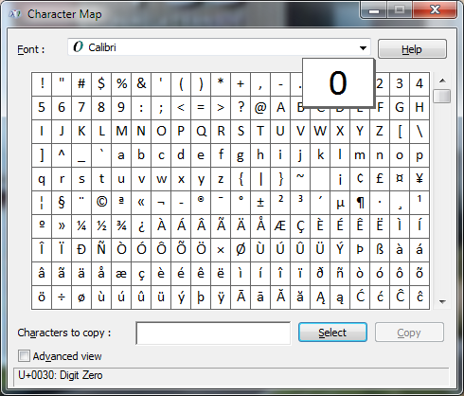
Character values
The Unicode standard gives each character a value
Java uses the Unicode numerical designation for each character
You can use Windows Character Map to see the designation
Zero is U+0030 which stands for Unicode Hexadecimal Character 30
Hex is base 16 so zero is 3*16 = decimal value 48
The digit characters have consecutive numerical values in order (0 through 9)

Slide 9
Checking if a character is in range
We want to see if the value is at least digit 1 and no more than differentDigits
We can add differentDigits to 0 to get the digit character corresponding to differentDigits
We will compare the character value in the array to the two edges of our range:
if (characters[i] >= '1' && characters[i] <= '0' + differentDigits) {
// In range
We can convert the digit into an integer so it can be compared against our secret code:
guess[i] = characters[i] - '0';

Slide 10
Checking the guess
We can check the guess against the code using static methods
Let’s start by counting the number of black pegs (number of correct digits in the same position in the guess and the secret code):
public static int countBlackPegs(int[] code, int[] guess) {
// Assume arrays are the same length.
// Loop through the elements of the arrays and count the ones that match.
int count = 0;
for (int i = 0; i < code.length; i++) {
if (code[i] == guess[i]) {
count = count + 1;
}
}
return count;
}

